Slide 1
TABLE OF CONTENT 1. Introduction 2. Business Questions 3. Methodology 4. Data Analysis 5.Recommendations 6. Conclusion

Slide 2
1.0 INTRODUCTION
This data analysis aimed to gain business insights from the historical data of a pizza company.
Examining factors such as hourly trends, weekly trends, various sales comparisons between pizza type, category, size and order frequency provides vital information to maximize revenue and enhance customer satisfaction

Slide 3
2.0 BUSINESS QUESTION
What is the Total Revenue?, How many order were placed?, What is the average order value?
How many total pizza were sold?, What is the average number of pizza per order?
How much quantity was sold per pizza category?, What is the most expensive pizza?
When are the peak ordering hours?
What is the average number of pizza ordered per day?
How do order vary by day of the week, month and quarter?
What is the category wise distribution of pizza?
Which is the top 5 best selling pizzas by number of order and top 5 pizza by quantity?
What are the top 3 pizzas per category based on sales and top 3 pizza type by sales?
What percentage of sales comes from category and size?
What is the common pizza size ordered?
What percentage of comes from pizza type?

Slide 4
3.0 METHODOLOGY
Excel and Power Bi were utilized to analyze the data sample and provide insights into the business questions.

Slide 5







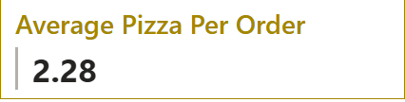
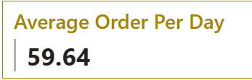
4.0 DATA ANALYSIS 4.1 KEY PERFORMANCE METRICS

Slide 6
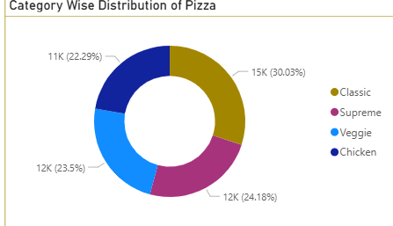
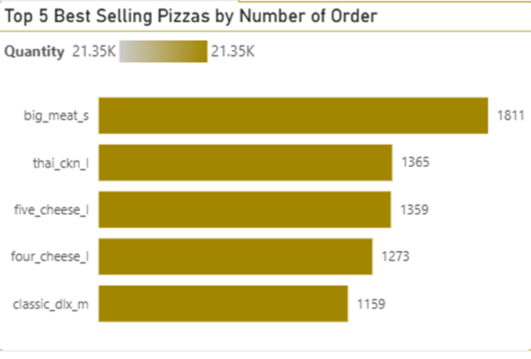
4.2 Insights
Classic Category contributes to Maximum Total Orders.
Chicken category contributes to minimum total order.
The Big Meat Small size contributes to the highest order.

Slide 7
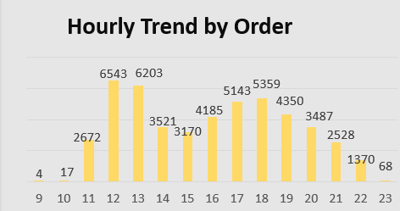
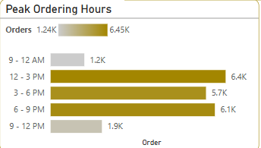
4.3 insights
EXCEL
Highest ordering hour is 12:00pm
POWER BI
Orders are high between the hour of 12-3pm

Slide 8
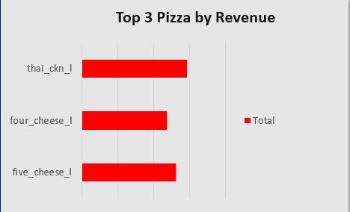
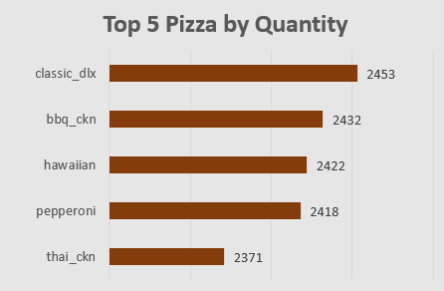
4.4 Analysis insight
The Thai chicken pizza contributes to maximum revenue.
The Classic Deluxe pizza contributes to maximum total quantities.

Slide 9
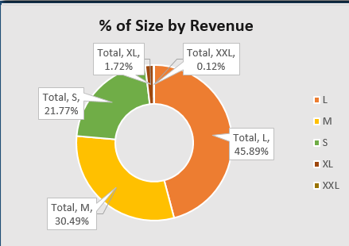
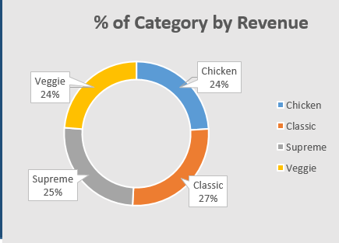
4.5 Analysis insights
Large pizza size has 45.89% shares of total revenue
Classic category has 27% shares of total revenue.

Slide 10
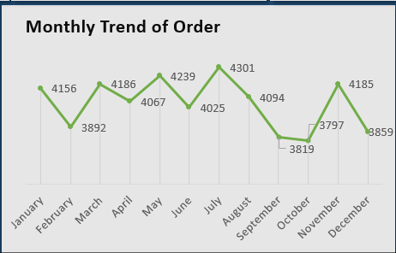
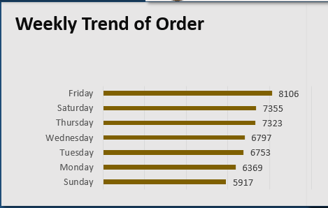
4.6 Analysis insights
The month with the highest order is July with 4239 orders.
Orders are high on weekends, Friday and Saturday.

Slide 11
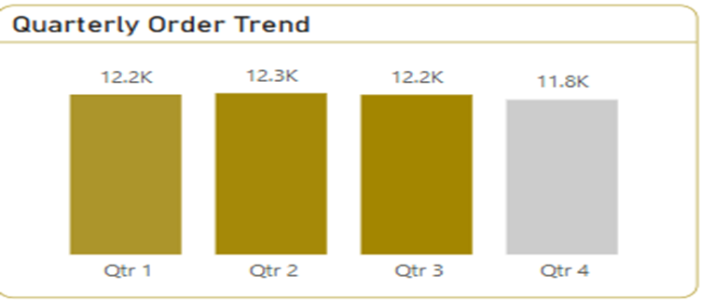
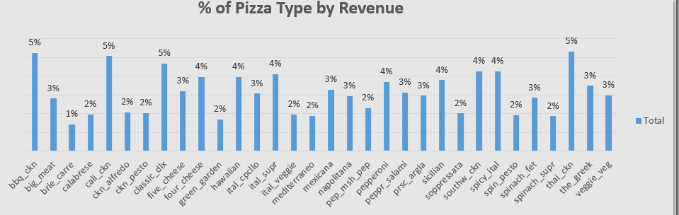
4.7 Analysis insights
Highest Order comes from the second quarter of the year.
Barbeque Chicken pizza, California chicken pizza, Classic deluxe, Thai chicken pizza has the highest percentage of revenue.

Slide 12
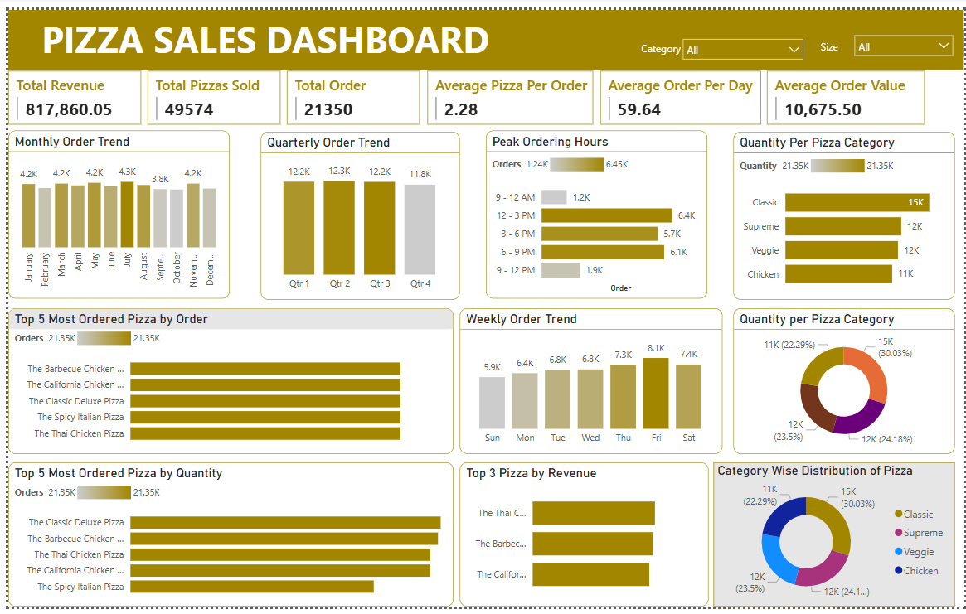
4.8 POWER BI DASHBOARD

Slide 13
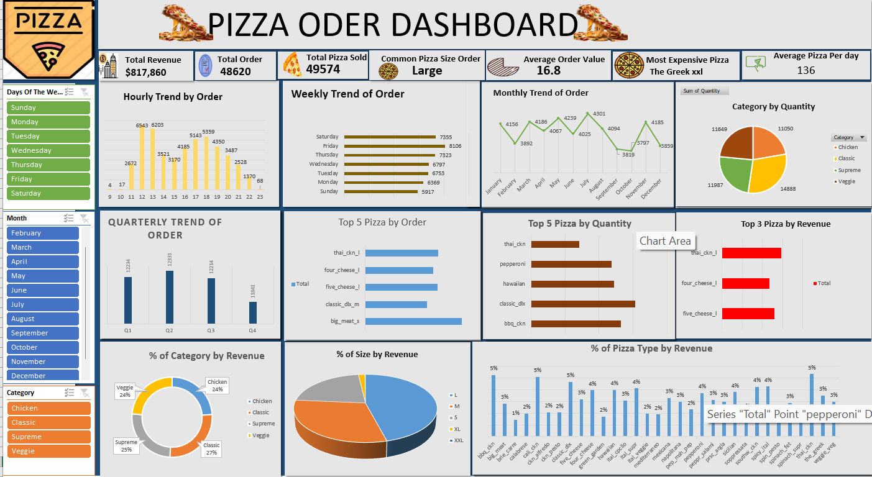
4.9 EXCEL DASHBOARD
4.9 EXCEL DASHBOARD

Slide 14
5.0 RECOMMENDATION
Introduce Online ordering.
Initiate customer loyalty programs.
Promote the best selling pizza.
Introduce and suggest complementary items to customers during ordering process.
Promote less selling pizzas through bundle deals or promo sales.
Disbursing enough staffs to attend to customers during high ordering hour.

Slide 15
6.0 CONCLUSION
The analysis provides valuable insights into customer purchasing trends, peak hours, weekly sales and critical details regarding pizza types, size and categories .,
Understanding these factors allows the business to optimize inventory, adjust staffing levels and implement strategies to maximize profits and enhance customer satisfaction.
Through the implementation of these recommendations and utilization of the analysis findings, the pizza company can improve customer happiness and sales which will ultimately result in higher revenue.

